Slide 1

Loan default analysis
AN VISUALIZATION

Slide 2
Introduction
Objective: To Analyze and understand the factors leading to loan defaults and propose strategies to mitigate risks.
You work for a consumer finance company which specialises in lending various types of loans to urban customers. When the company receives a loan application, the company has to make a decision for loan approval based on the applicant’s profile. Two types of risks are associated with the bank’s decision:
If the applicant is likely to repay the loan, then not approving the loan results in a loss of business to the company
If the applicant is not likely to repay the loan, i.e. he/she is likely to default, then approving the loan may lead to a financial loss for the company

Slide 3
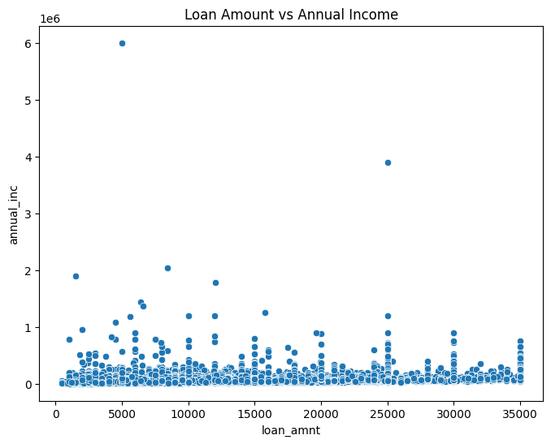
LOAN AMOUNT VS ANNUAL INCOME

Slide 4
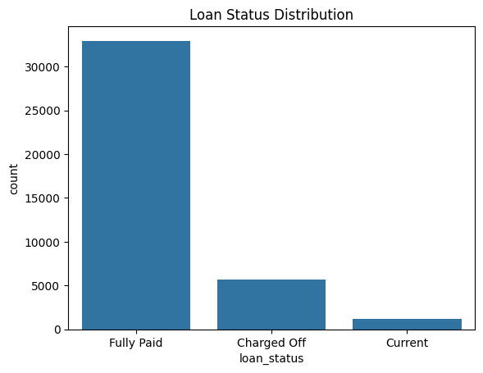
LOAN STATUS DISTRIBUTION

Slide 5
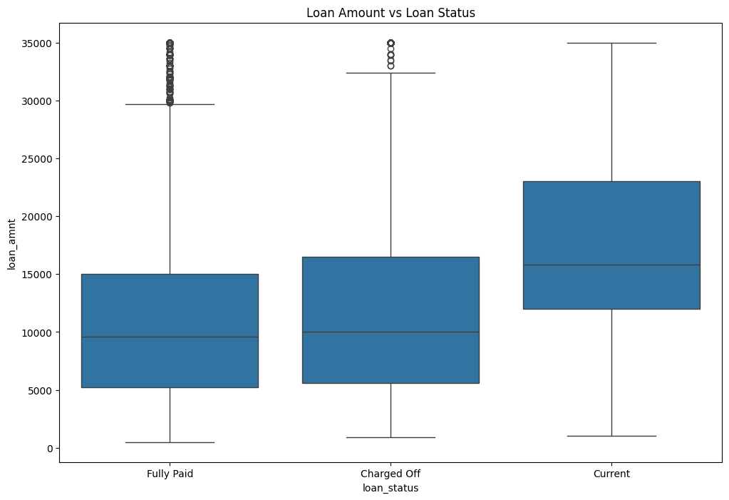
LOAN AMOUNT VS LOAN STATUS

Slide 6
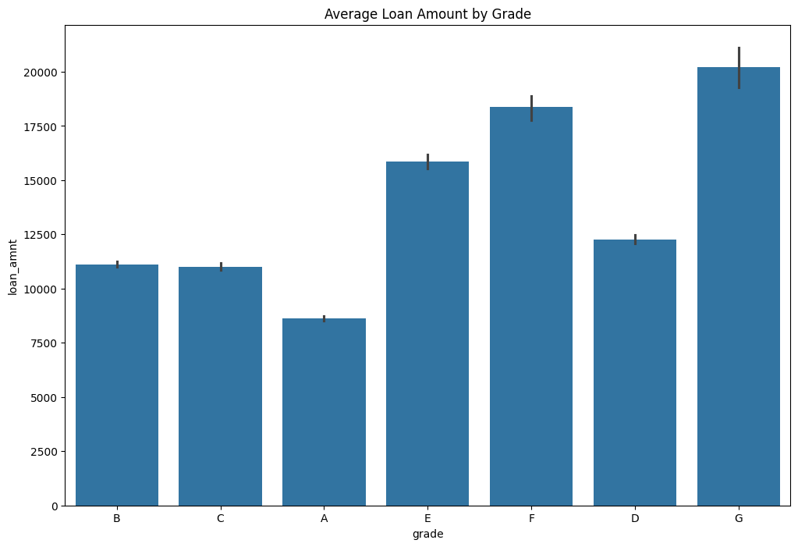
AVERAGE LOAN AMOUNT BY GRADE

Slide 7
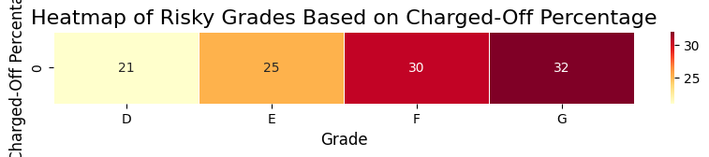
RISKY GRADES BASED ON CHARGED OFF

Slide 8
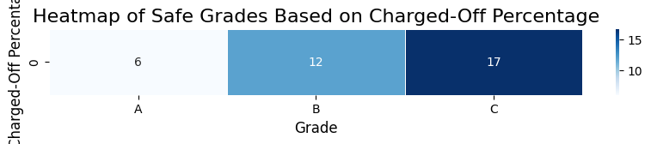
SAFE GRADE BASED ON CHARGED OFF

Slide 9
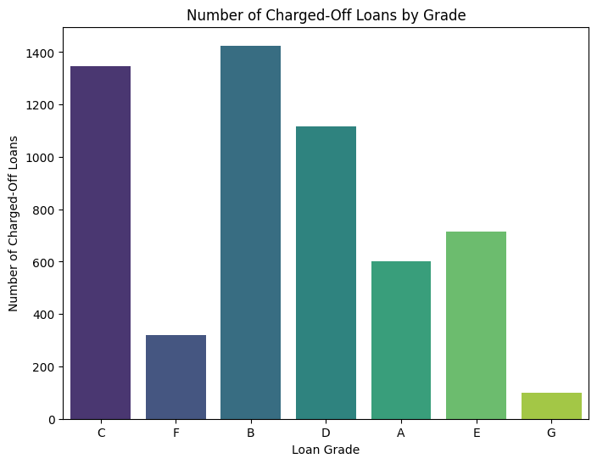
NUMBER OF CHARGED OFF LOANS BY GRADE

Slide 10
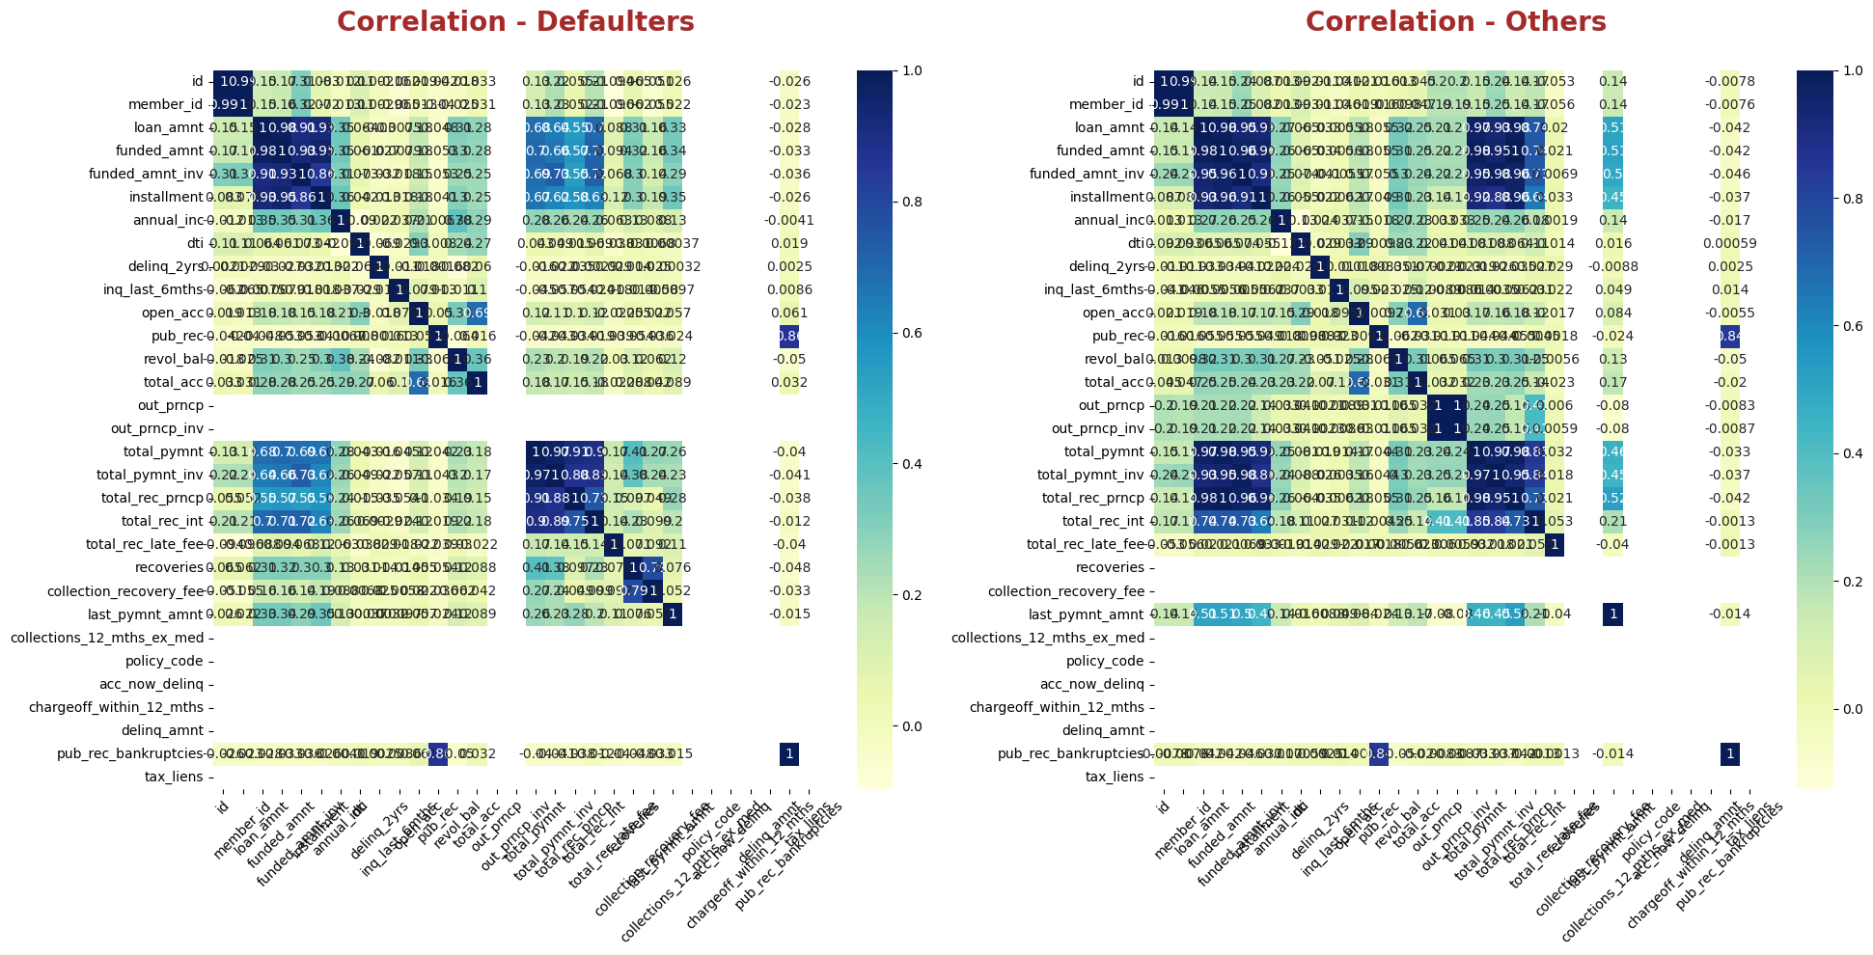
CORRELATION

Slide 11
In this analysis, we identified the loan grades that are at higher risk based on the percentage of loans that have been charged off.
We also analysed distribution part

Slide 12
Inference
Monitoring these grades can help in better managing risk and making informed lending
decisions, as they exhibit a higher potential for loan losses.

